Slide 1

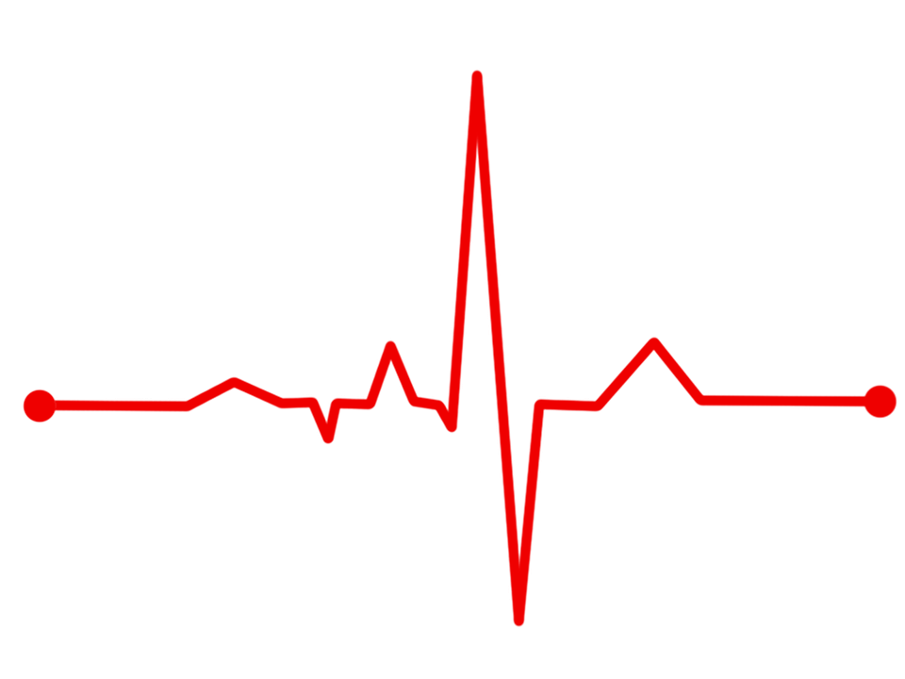

Heart Rate Monitoring System

Slide 2

DIY PROJECT
TEAM MEMBERS
Cherukuri Tapaswini Telu Amrutha Varshini Kolathuru Vishnu Vardhan Thummalapelli Jeevan Kumar
h

Slide 3

Components required
ARDUINO UNO
Pulse and Heartbeat Sensor (MAX30100)
LCD Screen
Bread Board
Connecting wires

Slide 4

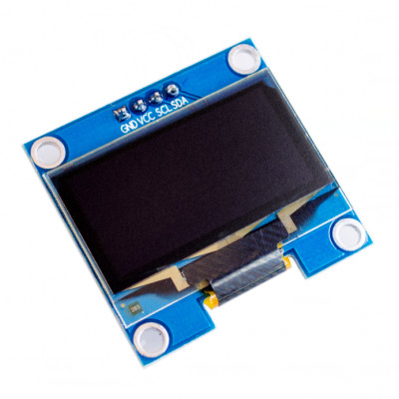
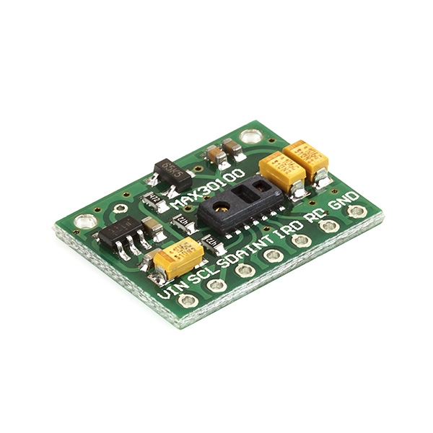
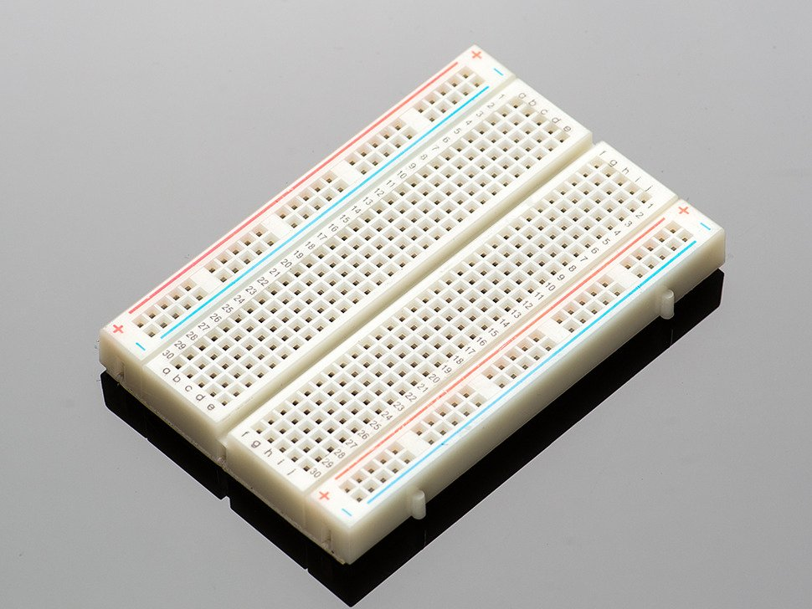
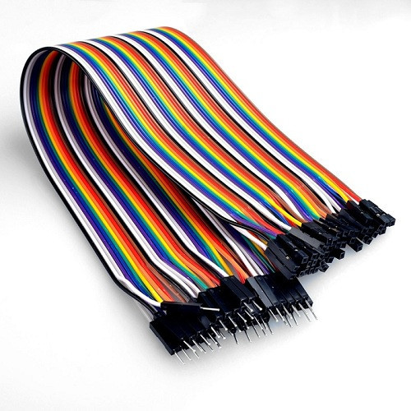
ARDUINO UNO
LCD SCREEN (BPM and SPO2 values)
Pulse And Heartbeat Sensor (MAX30100)
Bread Board
Connecting wires

Slide 5
We have chosen this PROJECT because...
A simple project involving Arduino UNO, LCD Screen and Heartbeat Sensor Module is designed here which can calculate the heart rate of a person.
This project can be used as an inexpensive alternative to Smart Watches and other expensive Heart Rate Monitors.
EEG, ECG and others health parameters can also be monitored.
Communications monitoring and future diagnosis can be the performed via the same system.
More than a single patient at different places can be monitored using such system.

Slide 6
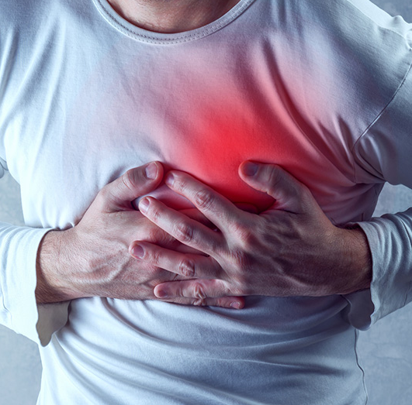
WHY Monitoring......?
More than 2 million people are at high risk of having heart attack.
It would be helpful if there was a way for these people to monitor their heart.
Our project focuses on how we can utilize this problem and find a solution.

Slide 7
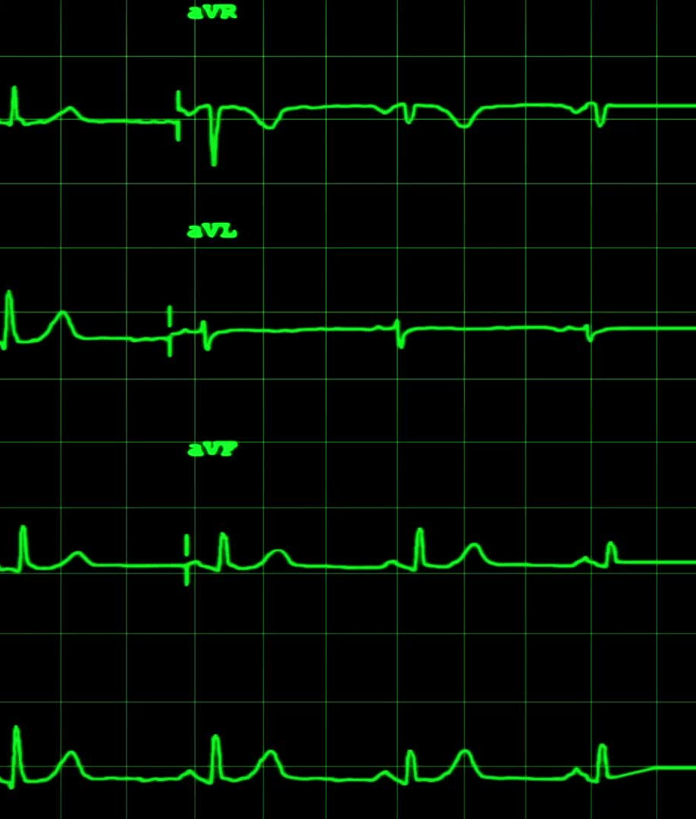
AIM OF THE PROJECT
In this project we are going to make a Heartbeat Detection and Monitoring System using Arduino that will detect the heartbeat using the Pulse Sensor and will show the readings in BPM (Beats Per Minute) on the LCD connected to it.

Slide 8
INTRODUCTION
Heartbeat sensor is designed to give digital output of heat beat when a finger is placed on it. When the heartbeat detector is working, the beat LED flashes in unison with each heartbeat.
This digital output can be connected to microcontroller directly to measure the Beats Per Minute (BPM) rate.
It works on the principle of light modulation by blood flow through finger at each pulse.

Slide 9

PROJECT OVERVIEW
We in this project are measuring the heartbeat using the IR Pulse Sensor & Arduino Uno.
The timer we have set for counting the heartbeat is 10 seconds.
There is a set point we can decide, after 10 seconds the heartbeat would be shown on the screen.

Slide 10
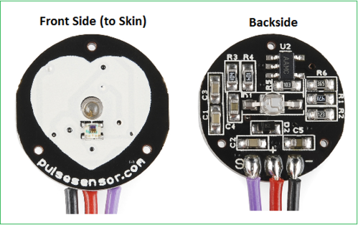
Pulse Sensor
Pulse sensors uses light-based technology to sense the rate of blood flow as controlled by the heart's pumping action.
It essentially combines a simple optical heart rate sensor with amplification and noise cancellation circuitry making it fast and easy to get reliable pulse readings.
It is often used non-invasively to make measurements at the skin surface.
It can provide valuable information about the cardiovascular system.

Slide 11

Working of Heartbeat sensor
The module uses an infrared led (IR) and a photo transistor to detect the pulse of the finger and whenever a pulse is detected, red LED flashes.
There will be LED on the light side of finger ad a photo transistor on the other side of the finger.
Photo transistor is used to obtain the flux emitted and the resistance of the photo resistor will change when the pulses will change.

Slide 12
MAIN ALGORITHM
Light from IR Emitter to blood
IR light reflected from circulating blood
Voltage variation in IR detector
Amplification by Op-Amp
Low pass filtration of data
Feed to Arduino for calculation
Processing sketch ( Heartbeat monitoring )

Slide 13

WORKING OF THIS PROJECT
When a heartbeat occurs, blood is pumped through the human body and gets squeezed into the capillary tissues. Consequently, the volume of these capillary tissues increases.
But in between the two consecutive heartbeats, this volume inside capillary tissues decreases.
This change in volume between the heartbeats affects the amount of light that will transmit through these tissues.
This can be measured with the help of a microcontroller.

Slide 14

Principle of Heartbeat Sensor
The principle behind the working of the Heartbeat Sensor is Photoplethysmography. According to this principle, the changes in the volume of blood in an organ is measured by the changes in the intensity of the light passing through that organ.
Usually, the source of light in a heartbeat sensor would be an IR LED and the detector would be any Photo Detector like a Photo Diode, an LDR (Light Dependent Resistor) or a Photo Transistor.
The light source and the detector can be arranged in two ways: A Transmissive Sensor and a Reflective Sensor.
In a Transmissive Sensor, the light source and the detector are placed facing each other and the finger of the person must be placed in between the transmitter and receiver.
Reflective Sensor, on the other hand, has the light source and the detector, adjacent to each other and the finger of the person must be placed in front of the sensor.

Slide 15
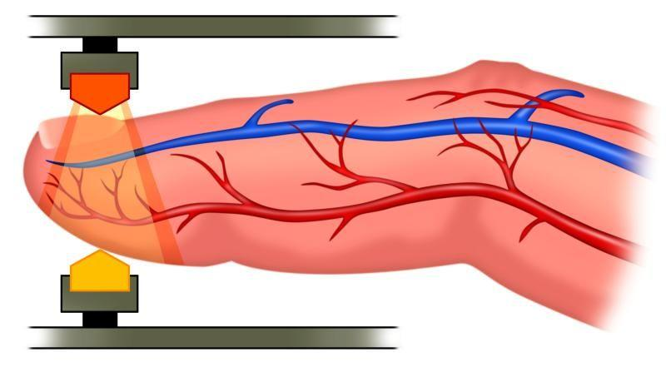
PureLight Sensor Technology
Pulse oximetry sensors use red and infrared EDS to measure deoxygenated and oxygenated hemoglobin.
LED contamination can affect the oximeter calibration, resulting in inaccurate SpO2 readings below 80%
Nonin sensors use Pure Light LEDs, which produce a high intensity pure light spectrum that consistently eliminates variations in readings from patient to patient and sensor to sensor.

Slide 16
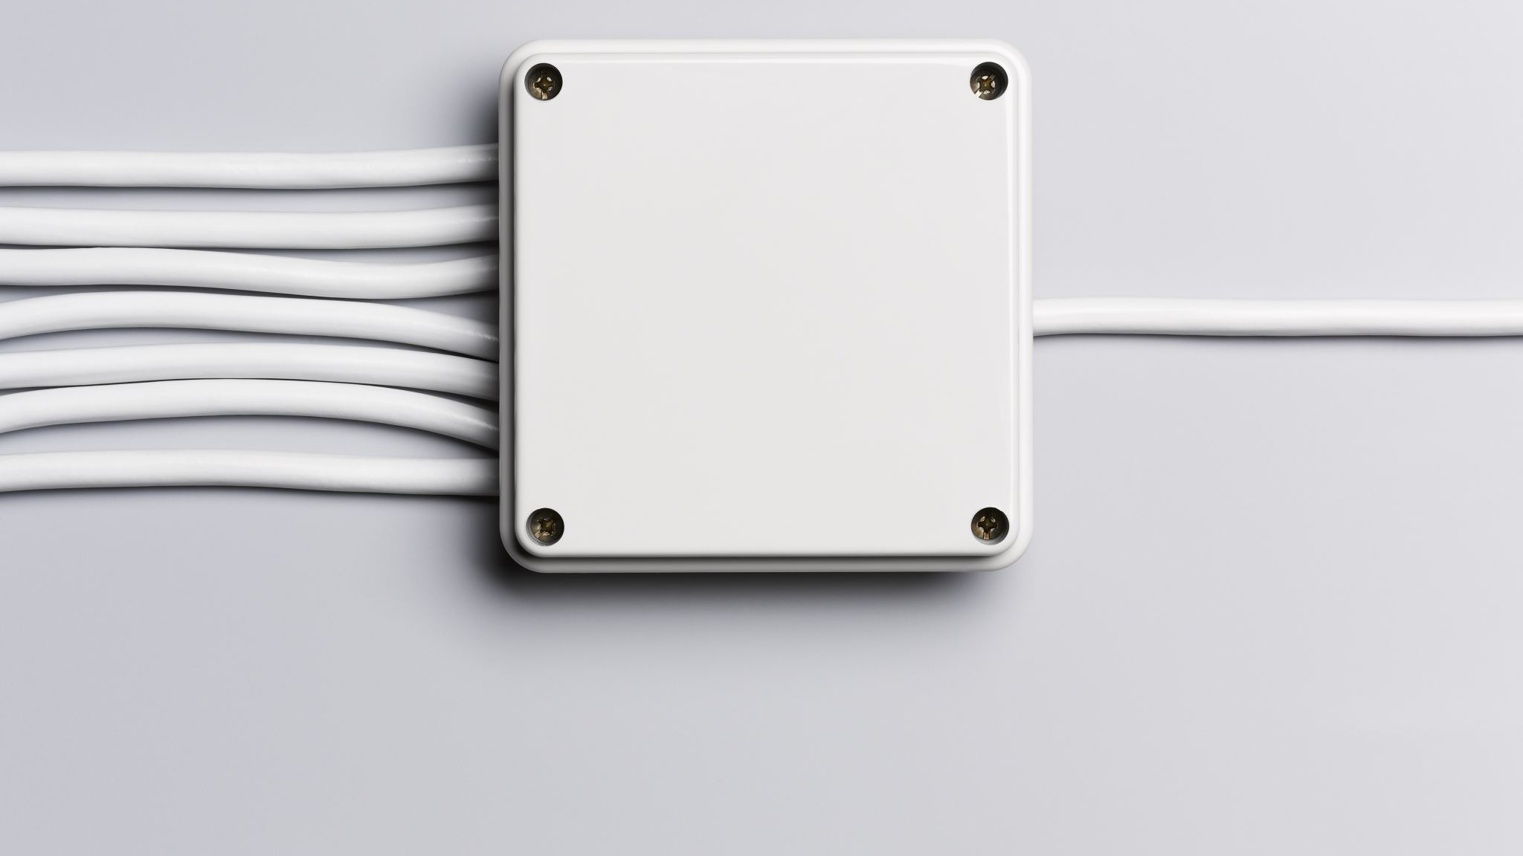
WHY Infrared sensor is used...?
The infrared sensor is responsible for sending infrared light to the body. This sensor has a pair of transmitter and receiver. Using photodiode, we can also detect reflective light from the body and this signal is sent to the microcontroller to detect heartbeat.

Slide 17
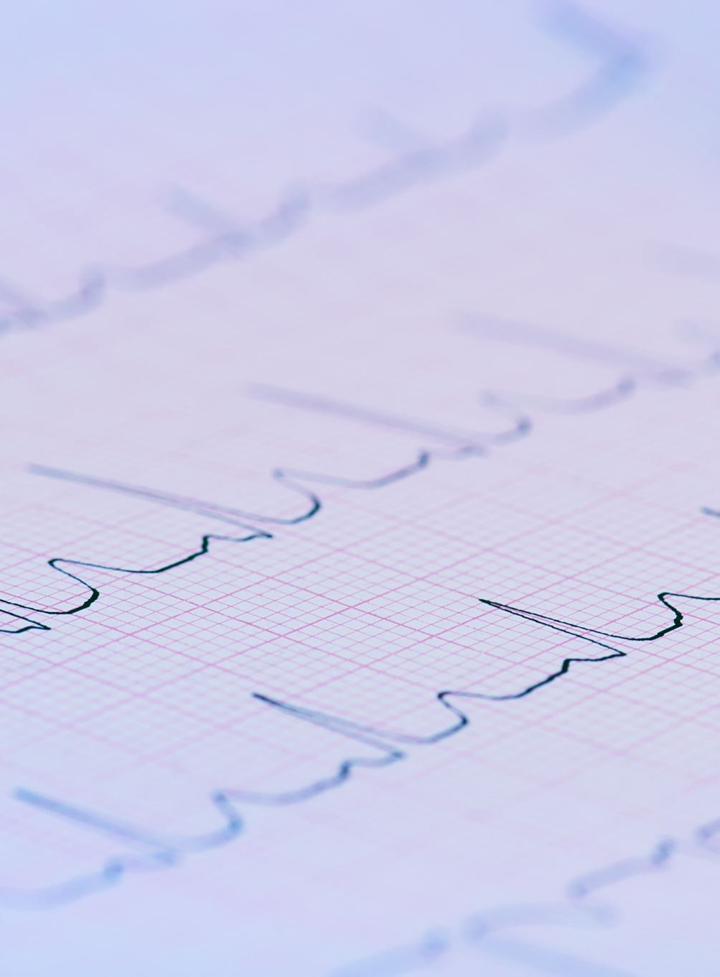
Working
The heartbeat is measured in beats per minute or bpm, which indicates the number of times the heart is contracting or expanding in a minute.
We use this technique to get the pulse from body and to amplify the signal and display this data on the LCD. Pulse oximeter is a particularly convenient non-invasive measurement instrument.
It measures the amount of oxygen in a patient's blood by sensing the amount of light absorbed by the blood in capillaries under the skin.

Slide 18
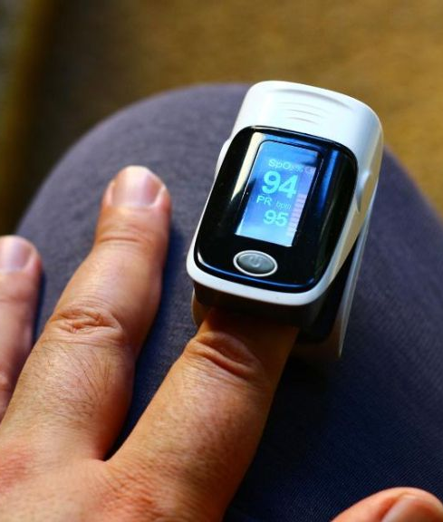
In a typical device, a sensing probe is attached to the patient's finger with a spring-loaded clip or an adhesive band. On one side of the probe is a pair of Light- Emitting Diodes (LEDs), and on the other side is a photodiode. One of the LEDs produces red light, and the other produces infrared light.
Pulse oximetry depends on the optical characteristics of hemoglobin, the blood protein that carries oxygen. When hemoglobin is more highly oxygenated, it becomes more transmissive to red light and more absorptive to infrared light. When hemoglobin contains little oxygen, it becomes relatively more transmissive to infrared, and more absorptive to red light.

Slide 19
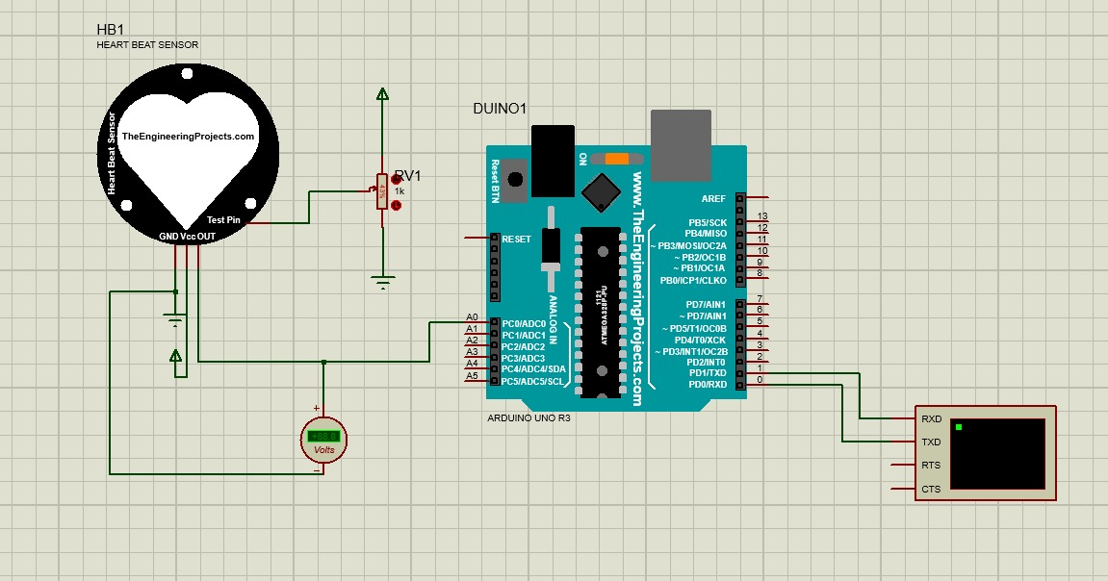
CIRCUIT DIAGRAM

Slide 20
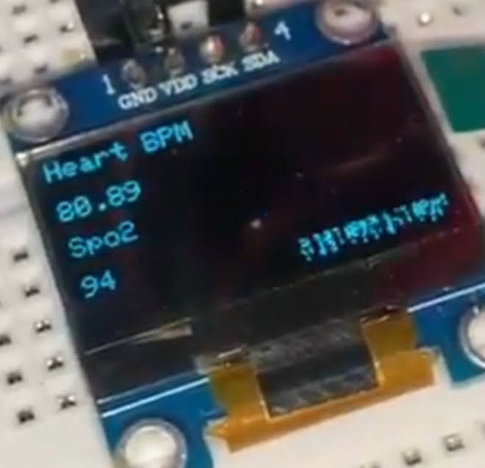
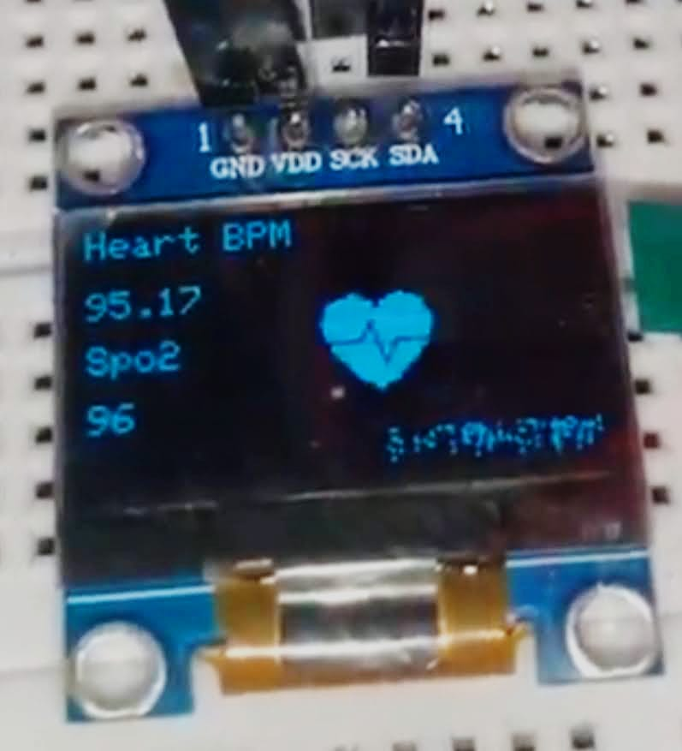
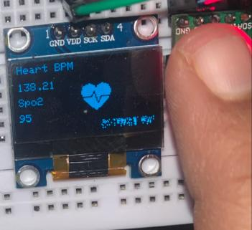
Heart rates observed during various activities
Resting Walking Exercising
SpO2 readings are 100% accurate and bpm readings are 95% accurate.

Slide 21
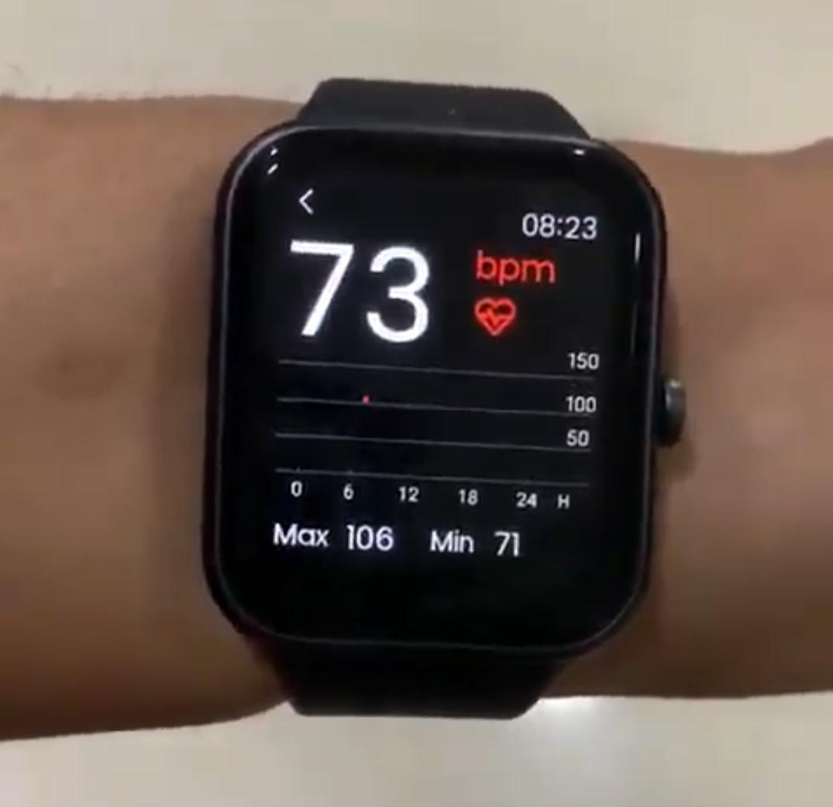
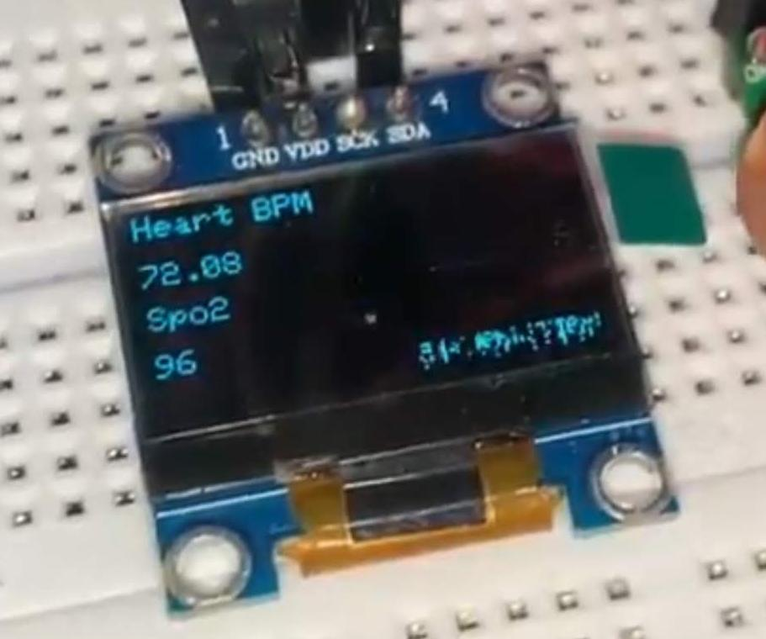
Comparing accuracy with a smartwatch

Slide 22

Problems faced while doing the project...
Initially, the LCD screen showed 0 Bpm, as there are some issues with the components and wiring.
ESP-8266 WI-FI MODULE did not get connected properly though code uploaded successfully.
IOT Analyser and Thingspeak didn't take up any data read by ESP8266.

Slide 23
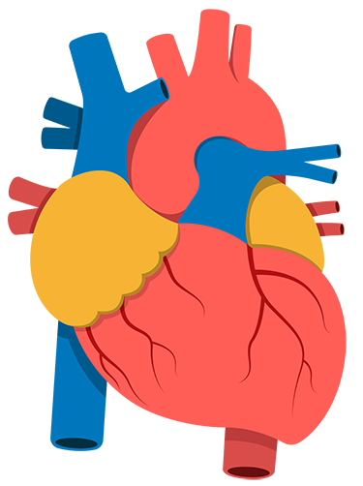
CONCLUSION
The Heart rate monitoring and pulse oximeter device available in market have high pricing where the designed device is the cheapest one.
The design proposes small size, light weight, low power consumption, standardized signal processing capabilities.
This device is also able to produce highly reliable test results for both heart rate and SpO2 level.
Our designed device has the advantage that it can be used by non-professional people at home to measure the heart rate and SPO2 level easily and safely.

Slide 24

FUTURE ENHANCEMENTS
This algorithm deals only with single patient and can be extended to multiple doctors and multiple patients.
￼ In future, we can also design PC software to analyze this received signal and generate the report and this can be sent back to the doctor.
￼ With the connection established between two ends we can also send patient's body temperature, blood pressure to doctor's side.

Slide 25

TEAM CONTRIBUTION
Electronics and Coding : Telu Amrutha Varshini
Presentation Making and
Info about Sensors : Kolathuru Vishnu Vardhan Hardware Assembly : Cherukuri Tapaswini Proteus stimulation : Thummalapelli Jeevan Kumar

Slide 26


